Slide 1

MORTGAGE PREDICTION FOR LOAN APPROVAL.
MACHINE LEARNING PROJECT GROUP 3

Slide 2
PROBLEM STATEMENT
We are trying to predict whether a loan would be approved or not based on certain given features.
The features includes;

Slide 3
PROBLEM DISCUSSION
Type of Machine Learning – Supervised Learning.
Prediction – Predicting a categorical variable.
Approach – Dataset collection, Data preprocessing, Model building and Model Testing.

Slide 4
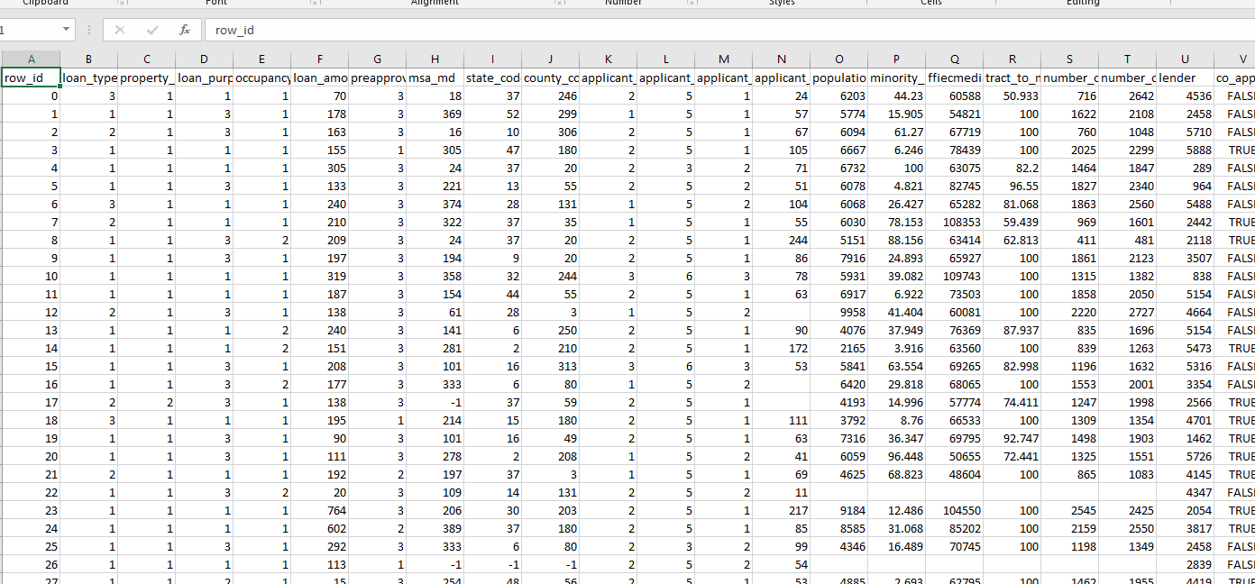
DATASET

Slide 5
Exploratory data ANALYSIS
Give Images for the EDA If Available

Slide 6
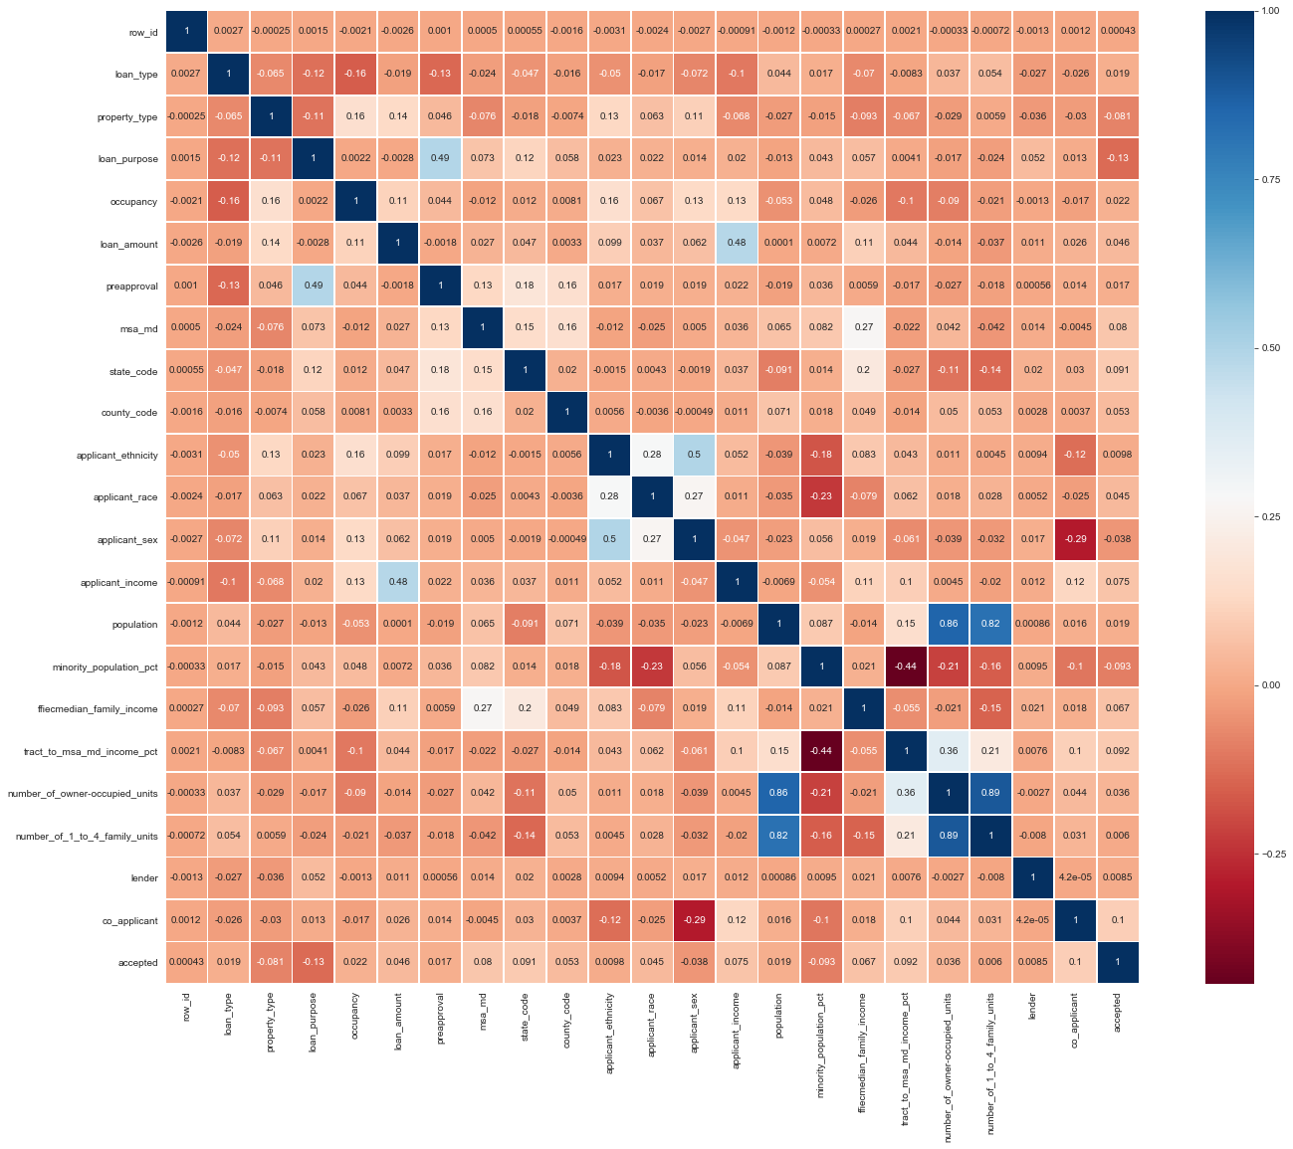
Correlation chart
Point out areas where we had correlations

Slide 7

MODEL BUILDING AND TESTING

Slide 8
MODEL BUILDING
State the train , test and Validate ratios
Algorithm used – Logistic Regression & Catboost Algorithm

Slide 9
MODEL BUILDING
DIFFERENCE IN ALGORITHM PERFORMANCE

Slide 10
MODEL TESTING
State results from both Algorithms in terms of Accuracy and Testing.

Slide 11

Thank You
s

Slide 12

ANY QUESTIONS

